Slide 1
Lung Cancer for the General Physician
North-West Thames GIM Specialist Trainee Study Day
14.30 – 15.30
16.2.18
Wolfson Lecture Theatre, Imperial College Healthcare Education Centre, 2nd Floor, Mint Wing, St Marys Hospital, South Wharf Road, London W2 1NY
Matthew Berry
Consultant Respiratory Physician,
Department of Respiratory Medicine, Imperial College Healthcare NHS Trust

Slide 2
Overview
Incidence, Survival & Risk Factors
Performance Status & why it matters
Presentation and diagnosis
Staging & why it matters
Treatments and outcomes
Surgery
Radiotherapy & Stereotactic radiotherapy (SABR/ Cyberknife)
Why tissue is the issue
Systemic treatments & outcomes: Chemotherapy, targeted therapies and immunotherapy
Palliative Care
Emergency presentations
SVCO; MSCC
Screening
Pulmonary nodules & what to do with them
Take home messages

Slide 3
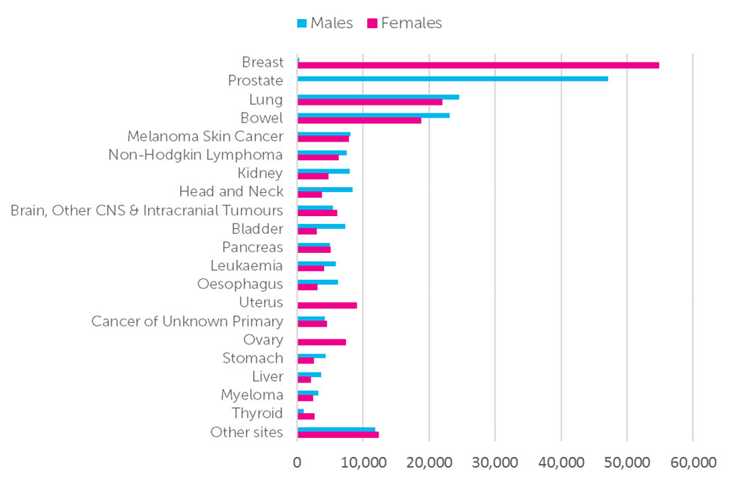

Lung cancer is common….
13% of all cancers
The Twenty Most Common Cancers: 2015

Slide 4
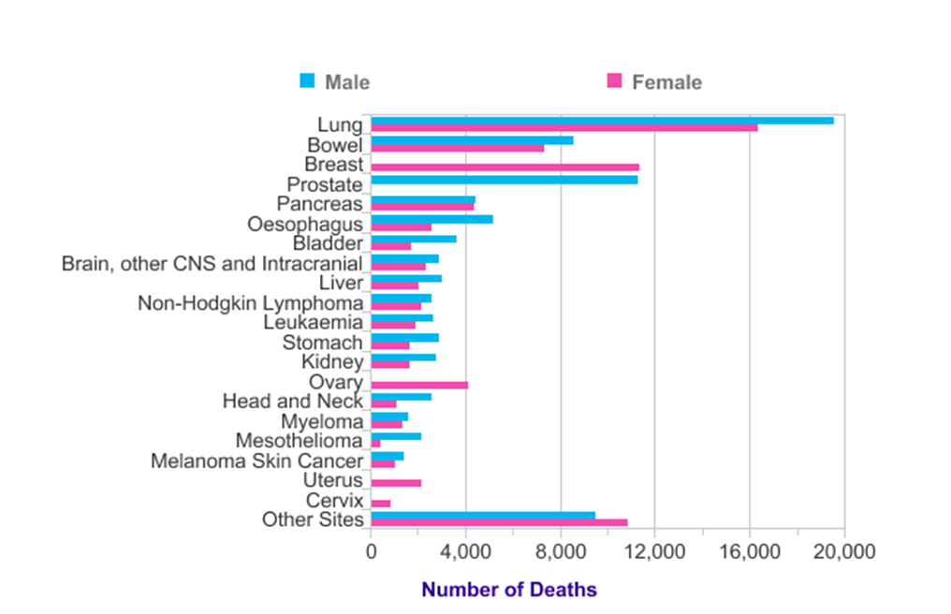
Lung cancer is common… & survival is poor
Lung cancer by far the most common cause of cancer death in the UK: 22% of all cancer deaths (2014)

Slide 5
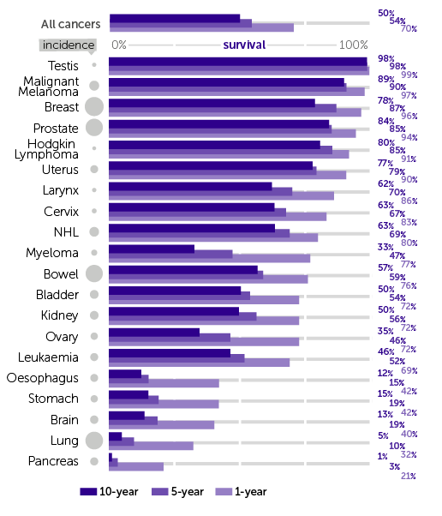
Lung cancer is common… & survival is poor
1 year survival 32%
5 year survival 10%
10 year survival 5%

Slide 6
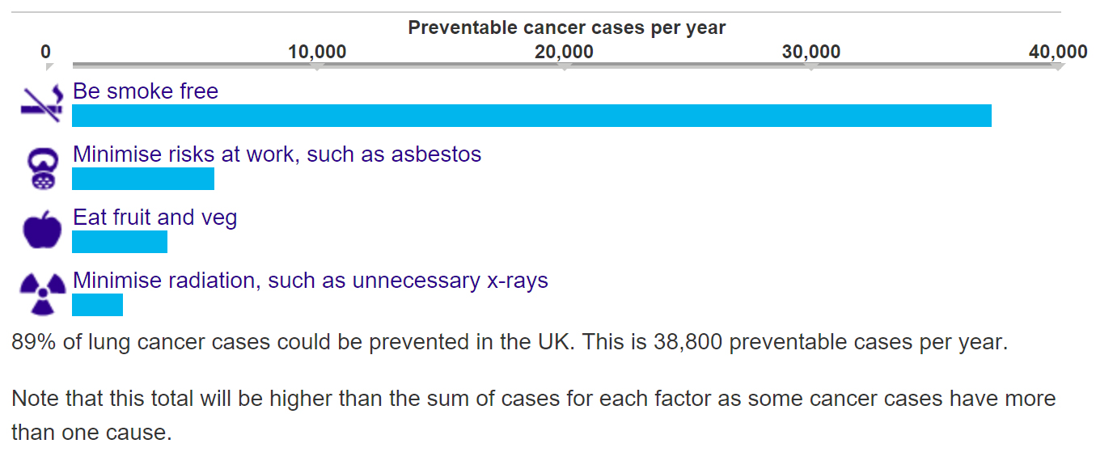
Lung cancer is common… & survival is poor & yet it is preventable
86%
13%
9%
5%

Slide 7
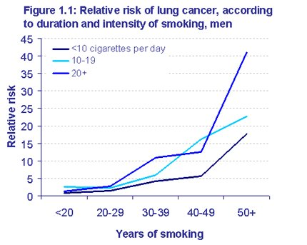
Smoking and lung cancer
1-4 / day = 3x RR death men; 5x women vs never smokers
Bjartveit K, Tverdal A. Health consequences of smoking 1–4 cigarettes per day. Tob Control 2005;14(5):315-20
8-12/day = 12x risk
25+/day = 24x risk
42/day = 39x risk
Pope CA, Burnett RT, Turner MC, et al. Lung cancer and cardiovascular disease mortality associated with ambient air pollution and cigarette smoke: shape of the exposure-response relationshipsEnviron Health Persp 2011;119(11):1616-21.

Slide 8
Smoking cessation: need to STOP
Reducing not enough
16-18/day smokers who halved their intake:
No reduction risk
Tverdal A, Bjartveit K. Health consequences of reduced daily cigarette consumption. Tob Control 2006;15(6):472-80
.
Lifelong male smoker: 15.9% risk of lung cancer death by 75; reduced to 9.9% if stop at 60
Women: 9.5% risk reduced to 5.3% if stop at 60; 2.2% if stop at 50.
Peto R, Darby S, Deo H, et al. Smoking, smoking cessation, and lung cancer in the UK since 1950: combination of national statistics with two case-control studies. BMJ 2000;321(7257):323-29

Slide 9
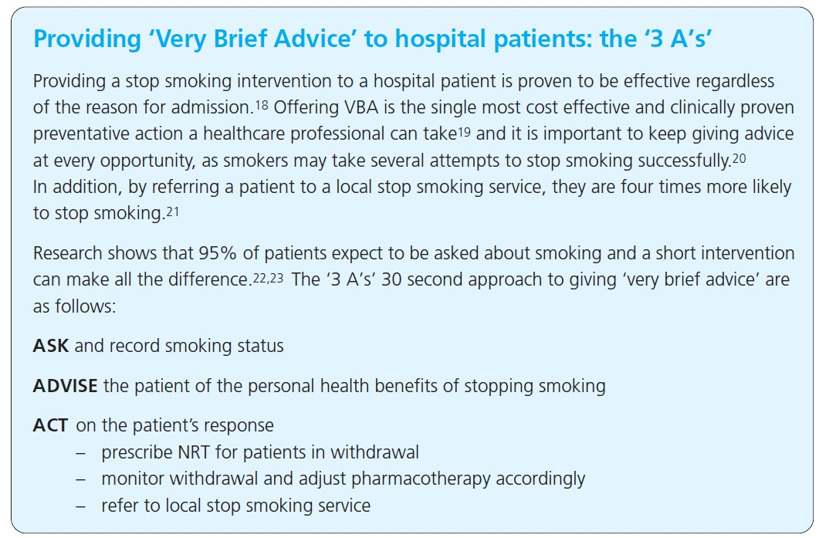
Help your patients to stop smoking
National referral system
https://nww.referralshub.eastmidlands.nhs.uk/NewReferral/imperial
Complete “very brief advice” training module
http://www.ncsct.co.uk/publication_very-brief-advice.php
ASK
ADVISE
ACT

Slide 10
Environment
Radon: radioactive gas from minute amounts of uranium in rocks & soils
Exposure to 100 radon Bq/m³: 16% increase lung cancer risk
Uranium miners
The radon level in the average UK home is 20 Bq/m³
Est 1400 cancer cases due to radon, but 87% in smokers
Air Pollution:
Long-term exposure to outdoor very small particles measuring < 10 mm diameter suspended in the air (particulate matter or PM10): increase lung cancer risk by 22% per 10µg/m³
Lung cancer death rates increased by 15% to 21% per 10 µg/m³ increase in PM10
Assoc with adeno; not squamous (smoking effect)

Slide 11
Asbestos
Mesothelioma
Increased risk of lung cancer death by 77%
8% total lung cancer deaths in UK
19-26x increased risk cancer death in smokers

Slide 12
Family History
First-degree relative: 51% increased risk of lung cancer, independent of smoking and other relevant factors
The effect is stronger with sibling (82% risk increase) than parent (25-37% risk increase)

Slide 13
Medical risk factors:
HIV/AIDS: 3 x Risk
Pneumonia:
35-36% increased risk never-smokers
TB
50-90% risk never-smokers
20yrs after diagnosis (Adenocarcinoma)
Emphysema
>2x risk
IPF:
Approx 4x RR; prevalence lung cancer in IPF (4.8% to 48%) >> without IPF (2.0% to 6.4%)
smoking, male gender, and age increase risk.
Lung cancers often occur peripheral where fibrotic changes predominant.
Radiotherapy (Lymphoma)- 5x
Diagnostic radiation
Estimate 120 cases

Slide 14
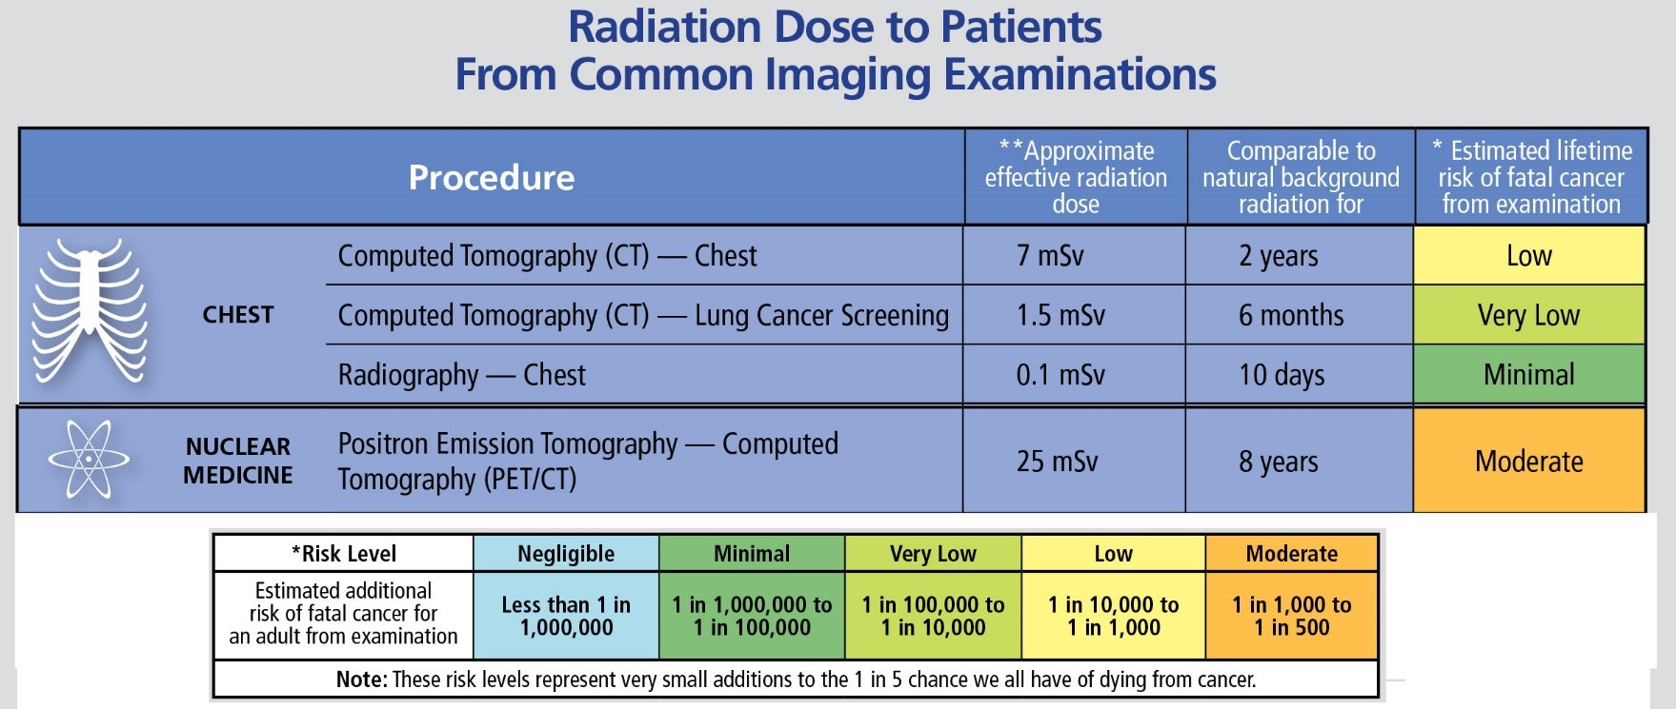
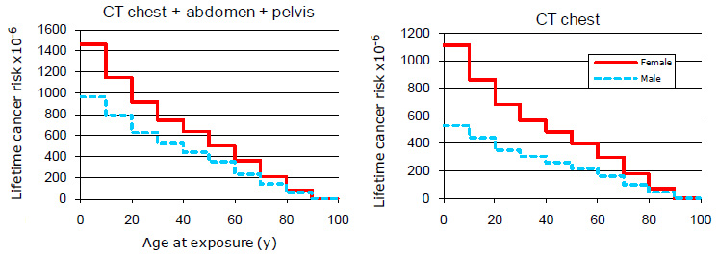
Be careful when ordering scans

Slide 15
Performance status
Performance status is a key determinant of prognosis
It is also a key inclusion/ exclusion criteria in clinical trials

Slide 16
Survival is related to performance status
Decreasing survival with increasing PS

Slide 17
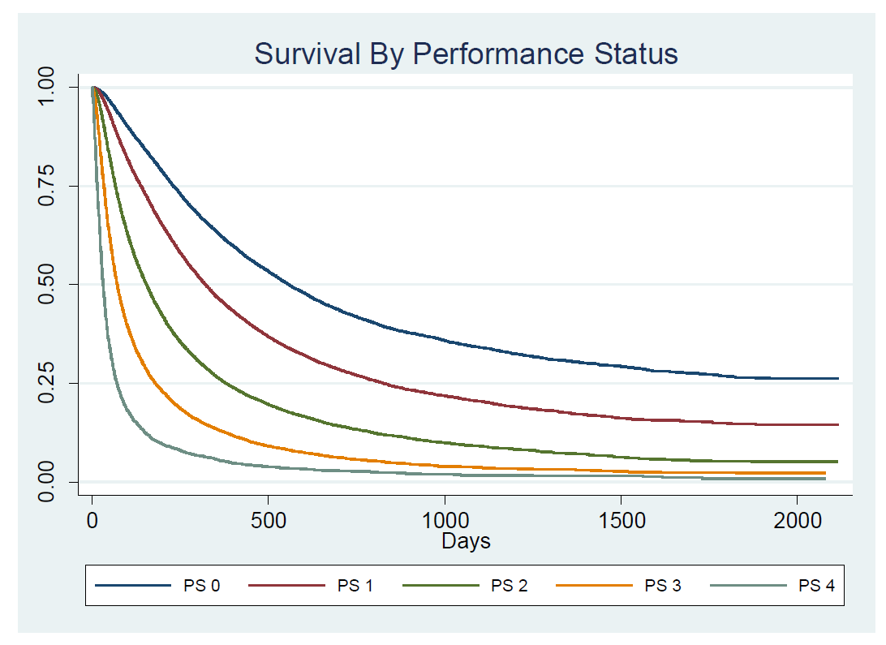
Performance Status & Survival

Slide 18
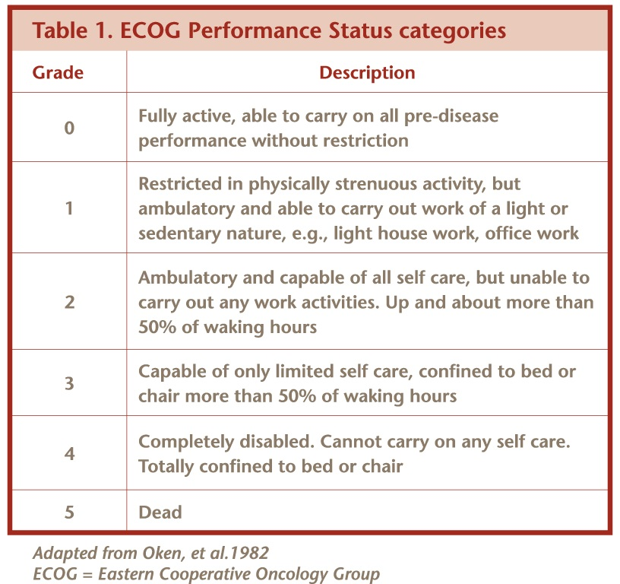
WHO Performance status: at time of assessment

Slide 19
Question 1 on performance status
A 82-year-old man attends the clinic to discuss treatment options for his newly diagnosed lung cancer. He is breathless on climbing stairs, but able to keep up with his contemporaries on the flat. He continues to do his housework.
A. PS 2
B. PS 1
C. PS 3
D. PS 0
E. PS 5

Slide 20
Question 1 on performance status
A 82-year-old man attends the clinic to discuss treatment options for his newly diagnosed lung cancer. He is breathless on climbing stairs, but able to keep up with his contemporaries on the flat. He continues to do his housework.
A. PS 2
B. PS 1
C. PS 3
D. PS 0
E. PS 5

Slide 21
Question 2 on performance status
A 45-year-old teacher who plays tennis regularly is admitted to hospital with breathlessness. She mobilises to the bathroom but otherwise is always in bed or chair on the ward as her breathing limits her.
A. PS 2
B. PS 1
C. PS 3
D. PS 0
E. PS 4

Slide 22
Question 2 on performance status
A 45-year-old teacher who plays tennis regularly is admitted to hospital with breathlessness. She mobilises to the bathroom but otherwise is always in bed or chair on the ward as her breathing limits her.
A. PS 2
B. PS 1
C. PS 3
D. PS 0
E. PS 4

Slide 23
How do people present? Who should you refer?
Symptoms and signs Frequency (%)
Cough 10-75
Weight loss 0-68
Dyspnoea 5-60
Chest pain 20-50
Haemoptysis 6-35
Bone pain 6-25
Clubbing 0-20
Weakness 0-10
SVCO 0-10
Stridor 0-4
Dysphagia 0-2

Slide 24
Referral: NICE CG12 June 2015
Refer 2WW for lung cancer if :
CXR findings (of cancer) or
aged >40 with unexplained haemoptysis [new 2015]
CXR(within 2 weeks) in people aged 40 and over if 2 or more unexplained symptoms, or if ever smoked and 1 or more:
Cough, fatigue, shortness of breath, chest pain, weight loss, appetite loss. [new 2015]
Consider urgent CXR (2 weeks) 40 and over with any of:
persistent or recurrent chest infection, finger clubbing, supraclavicular lymphadenopathy or persistent cervical lymphadenopathy, chest signs consistent with lung cancer, thrombocytosis. [new 2015]

Slide 25
Lung cancer pathway Diagnose Stage Select best treatment Quickly!
MDT involvement
Referral
Diagnosis, Staging and assessment
Treatment planning

Slide 26
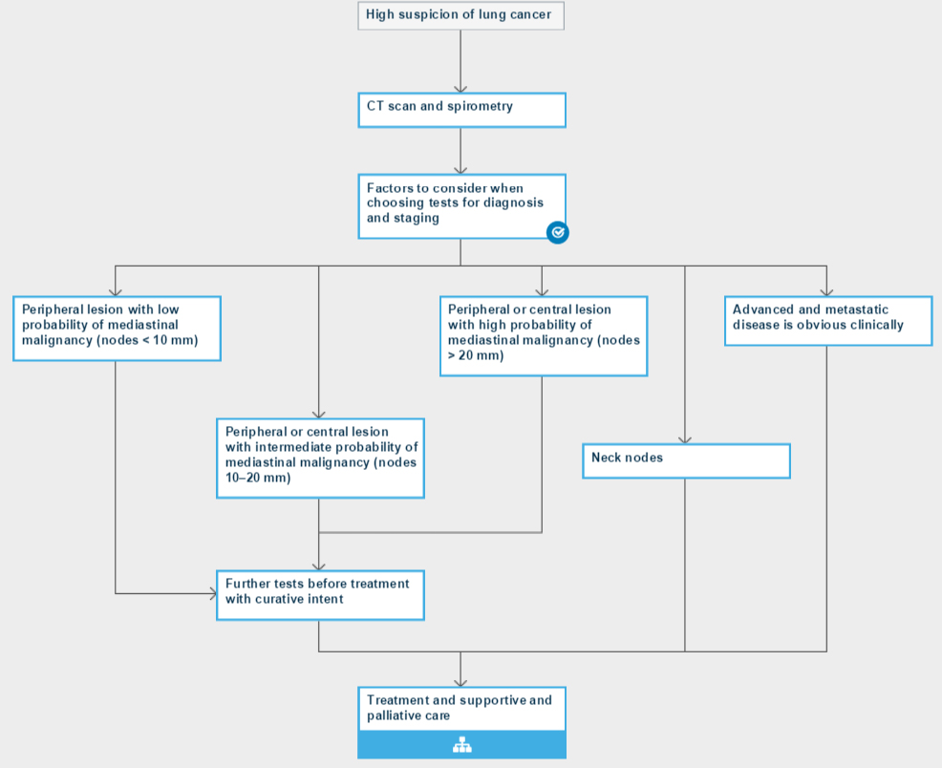

Diagnosis
contrast CT scan chest, liver and adrenals (caution with renal disease)
(consider neck)
Spirometry, measure TLCO if disproportionate breathlessness or other lung pathology.
Chest CT should be performed before bronchoscopy or any other biopsy procedure

Slide 27

Diagnosis
Choose tests that give the most information with the least risk.
Avoid only diagnostic tests when staging will guide treatment.
Take adequate samples to get detailed pathology (tumour sub-typing and measurement of predictive markers)
Sample mediastinum or mets NOT primary if stage affects treatment
Bronchoscopy only if nodal staging doesn’t affect treatment: otherwise EBUS
EBUS for paratracheal & peri-bronchial lung lesions

Slide 28
Diagnosis
Sample highest stage / safest site; ensure sufficient for EGFR testing
CT/MR Brain; PET; XR/MRI for bone
PET + Biopsy
EBUS/EUS +/- Mediastinoscopy
PET or EBUS/EUS +/- Mediastinoscopy
Neck nodes +/- EBUS/EUS
PET, CT/MRI Brain, biopsy exclude mets, Sample mediastinum

Slide 29
Stage is the other key determinant of survival

Slide 30
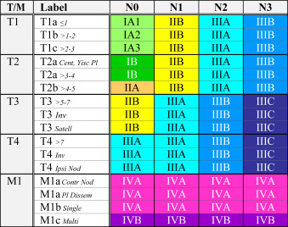
Staging
Roughly:
T stage = primary
Size main det
N = nodes:
1- local;
2 ipsilateral
3 contralateral (neck)
M = mets
1a lung/ pleura
1b single met
1c multi mets

Slide 31
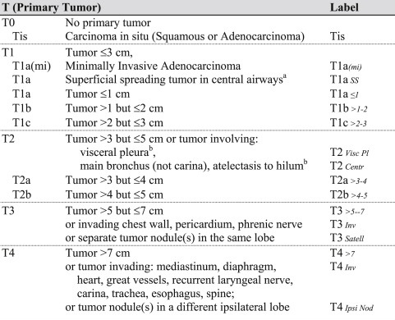
T stage
SIZE and INVASION
CHEST 2017 151, 193-203DOI: (10.1016/j.chest.2016.10.010)

Slide 32
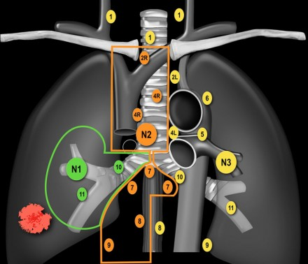
N stage
Ipsilateral hilar N1
Ipsilateral midline N2
Contralateral or neck: N3

Slide 33
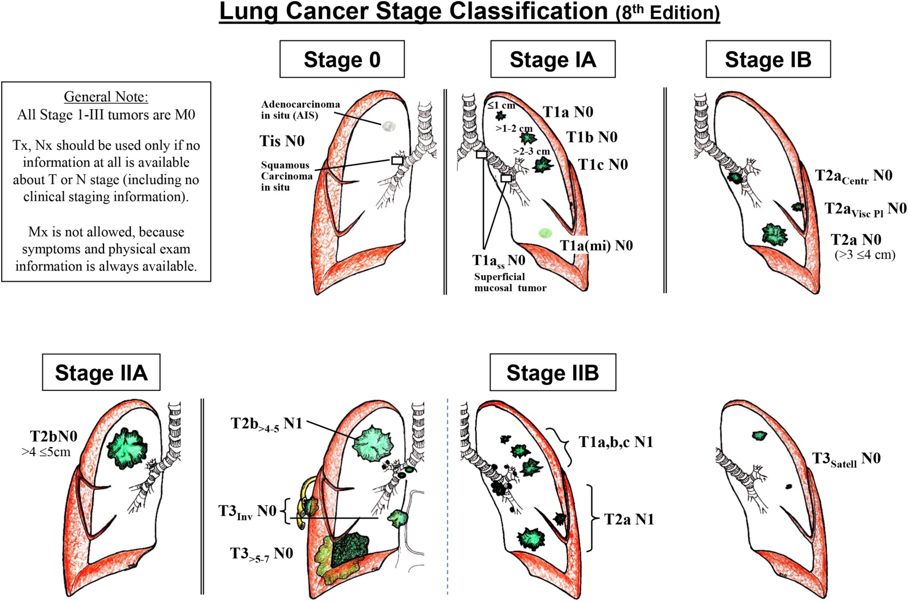
Resectable 0- IIB: higher grades will need adjuvant chemo
CHEST 2017 151, 193-203DOI: (10.1016/j.chest.2016.10.010)

Slide 34
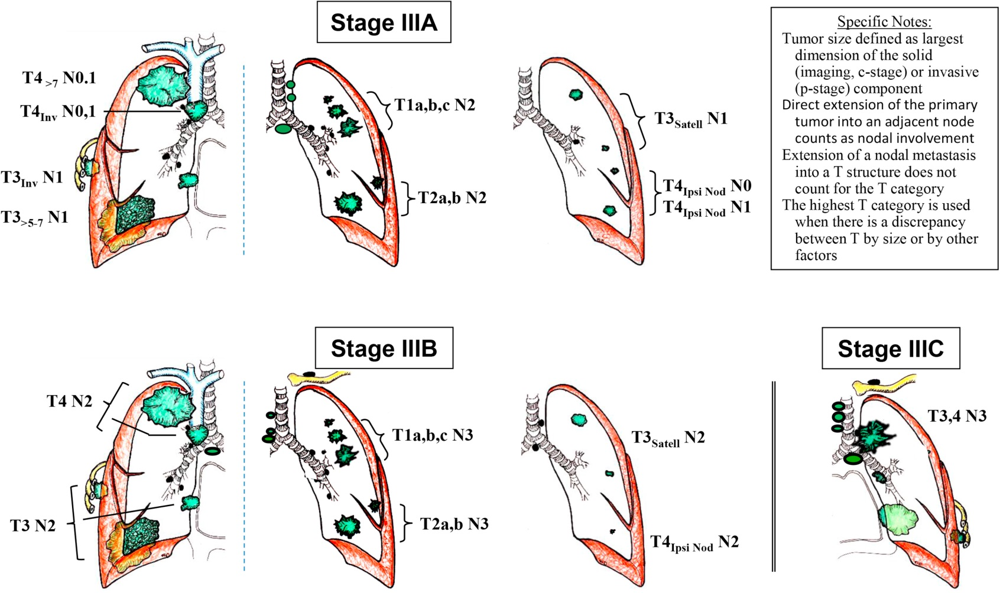
IIIA/B Not resectable but radical chemorad?
CHEST 2017 151, 193-203DOI: (10.1016/j.chest.2016.10.010)

Slide 35
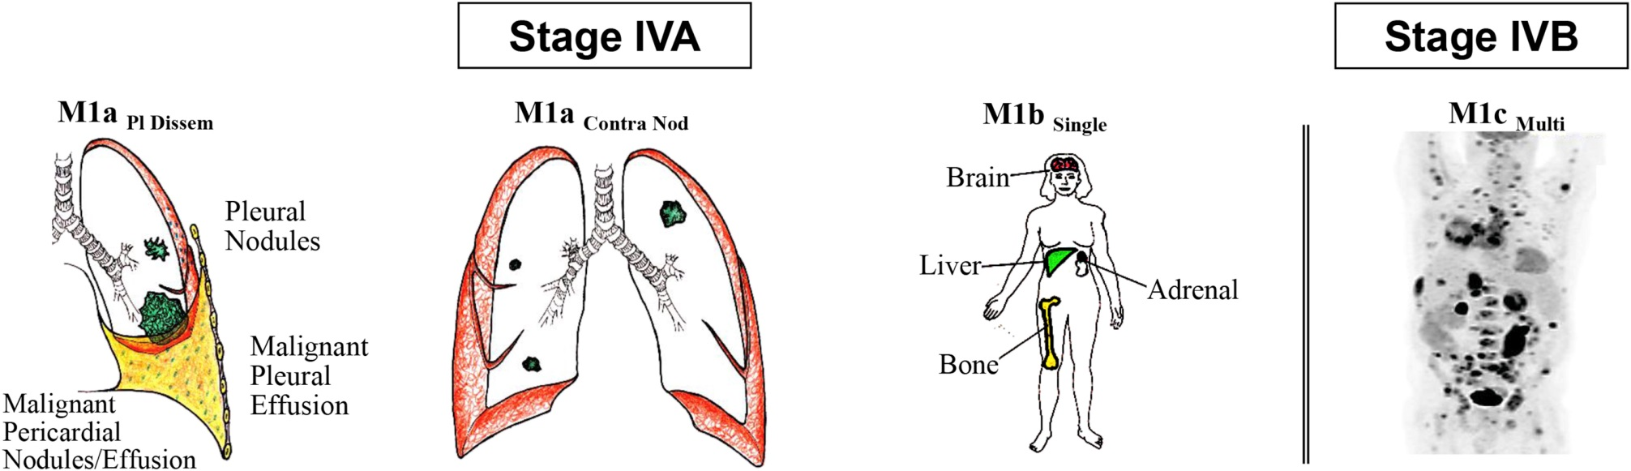
IV: Mets: Palliative/ Systemic treatment mostly*
Sometimes explore resection of solitary met and primary but not curative
CHEST 2017 151, 193-203DOI: (10.1016/j.chest.2016.10.010)

Slide 36
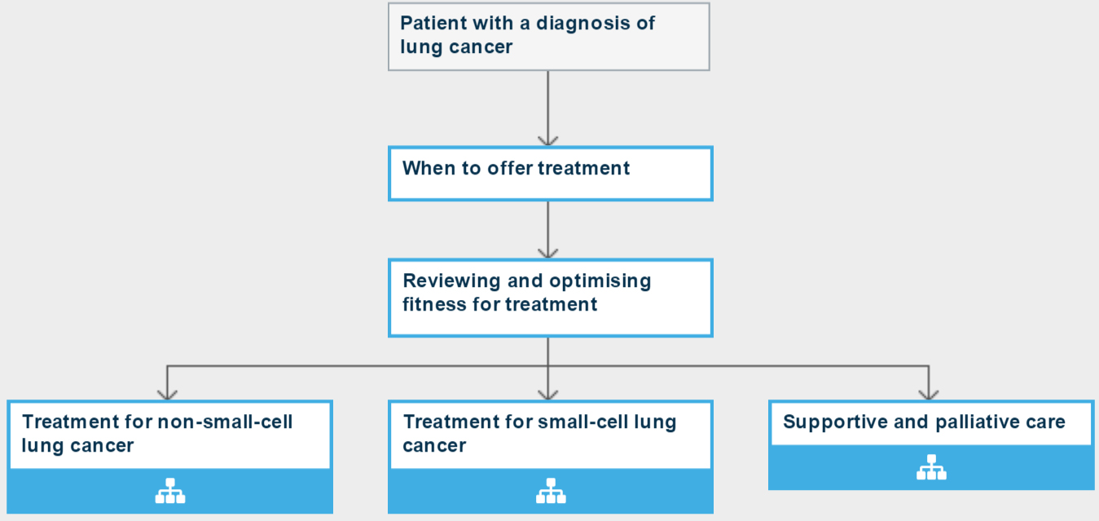

Treatment
62 days from GP 2WW
31 days from decision to treat.

Slide 37
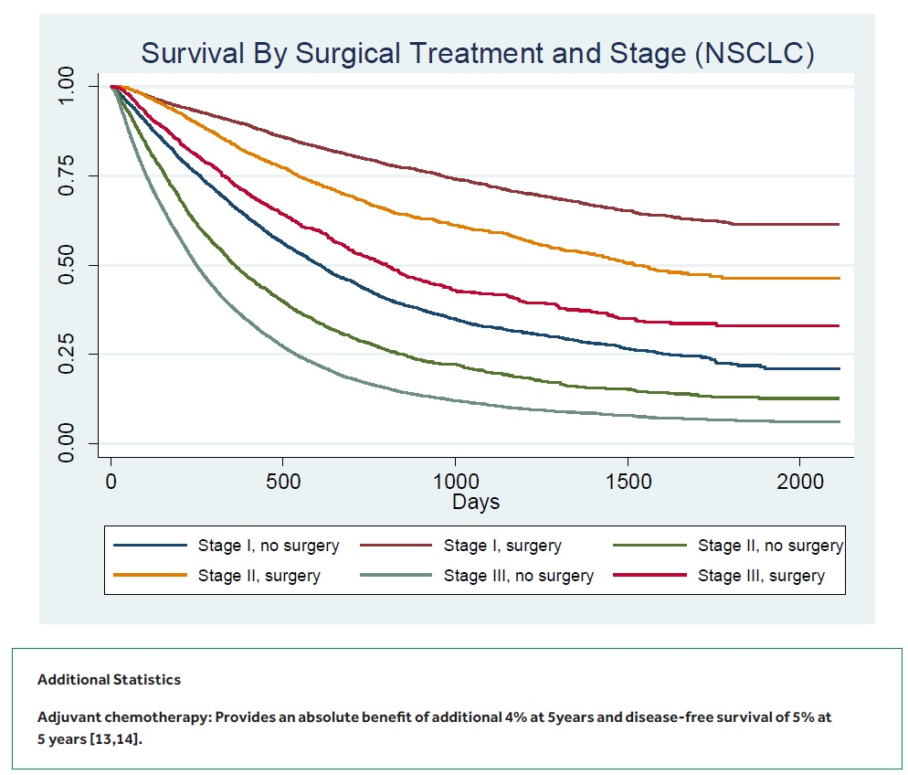
Treatments: Surgery

Slide 38
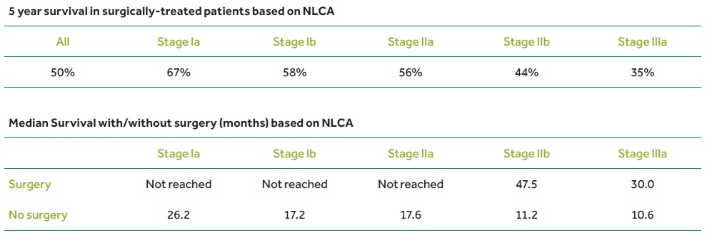
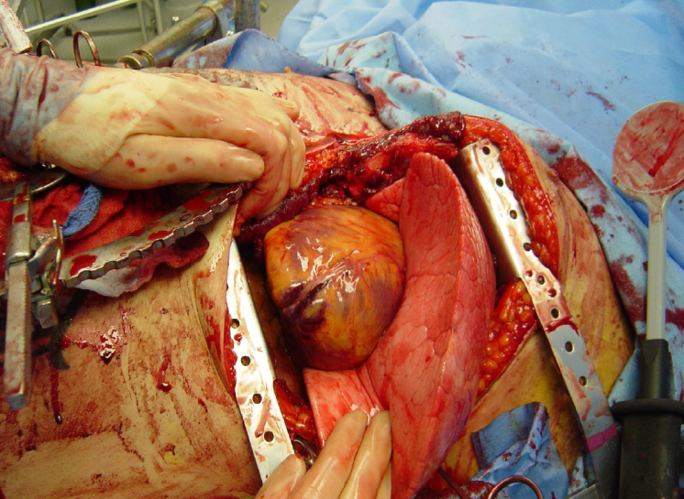
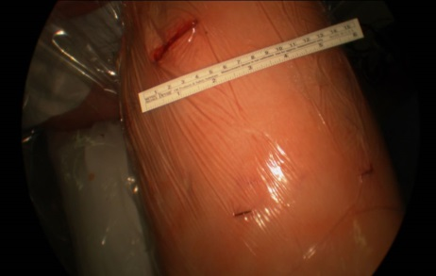
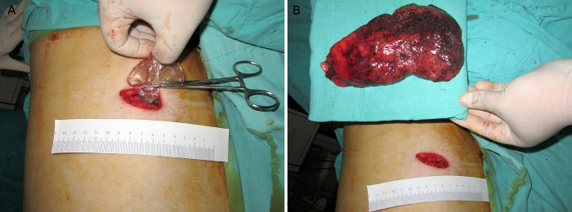
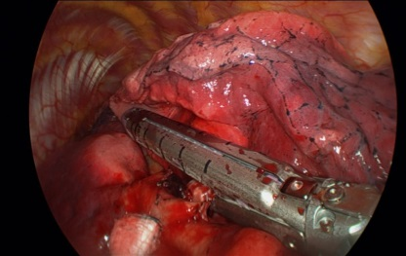
Treatments: Surgery
Thoracotomy
VATS

Slide 39
Treatments: Radiotherapy
Radical:
Mon-Fri every day, 4-6 weeks; rash, fatigue; scarring (cough/ breathlessness)
Cochrane review conventional radical radiotherapy for early stage lung cancer, overall survival varied between;
33-72% at two years
17-55% at three years
0-42% at five years.
Complete response rates were 33-61% and local failure rates between 6-70%
SABR/ stereotactic/ “cyberknife”: usually 3-5 visits (planning , then dosing, consecutive days) - currently RMH Sutton; MVH, Watford
Long term outcome data from SABR/SBRT is still scarce.
early studies of SABR/SBRT for early stage lung cancer showed three year survival rates of 56% and 71%. Local control at three years was 91% and 80% respectively. Overall survival at three years was better for stage IA patients (79%) than stage IB patients (56%).
Median survival improves from 1 month to 3-6 months after whole brain radiotherapy for metastases with 10-20% 1 year survival.

Slide 40
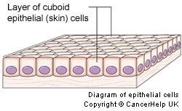
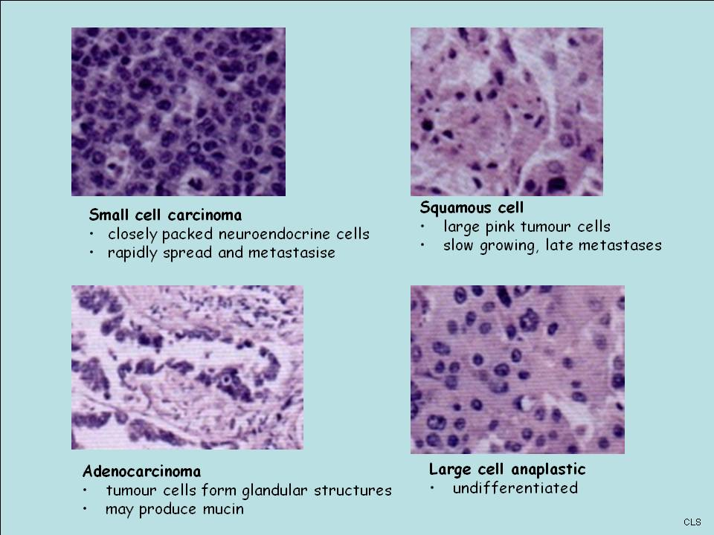
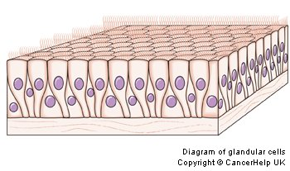
Tissue is the issue: different Lung cancers
Epithelial (non-small cell)
Squamous
Adenocarcinoma (Glandular)
Neuroendocrine
Small cell
Carcinoid
Rarer tumours from other cell types:
Angiosarcoma
Myosarcoma
Lymphoma
THERE IS NEVER A ROLE FOR TUMOUR MARKERS IN UNDIAGNOSED MALIGNANCY

Slide 41
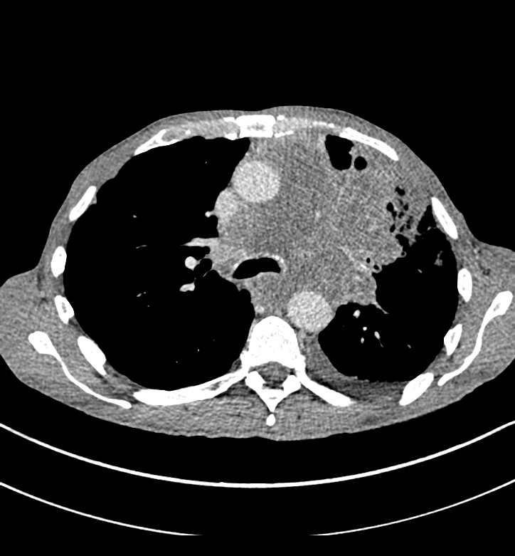
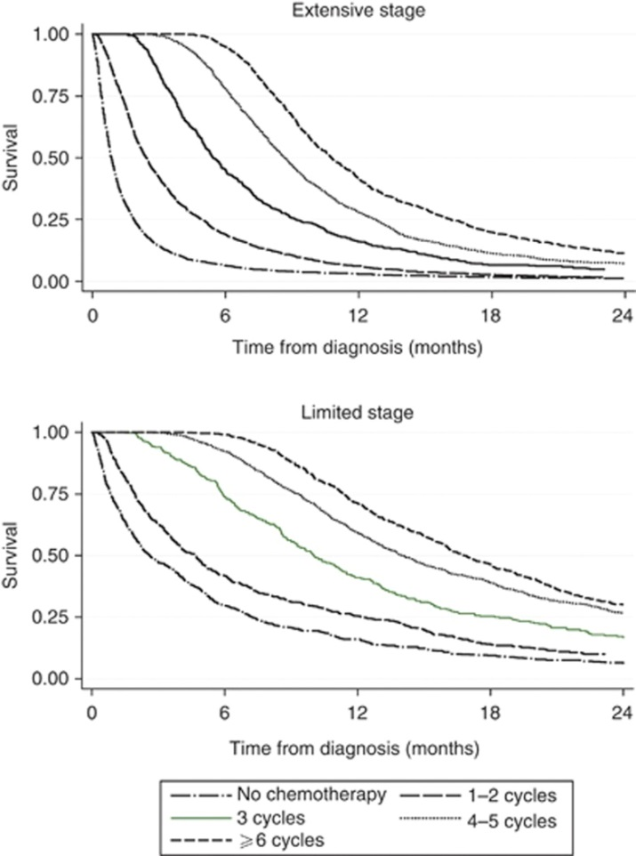
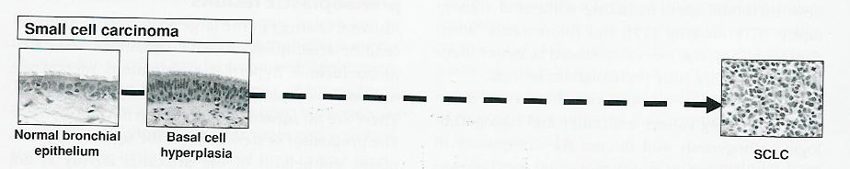
Small cell
Rapidly progressive
median survival 6 months for all patients,
1 year for those with limited stage
4 months for extensive stage/ no chemo
Br J Cancer. 2014 Feb 18; 110(4): 908–915.
Wistuba & Gazdar, Ch 5, p84-98, in Lung Cancer, 3rd Ed. Roth, Cox & Hong 2008.

Slide 42
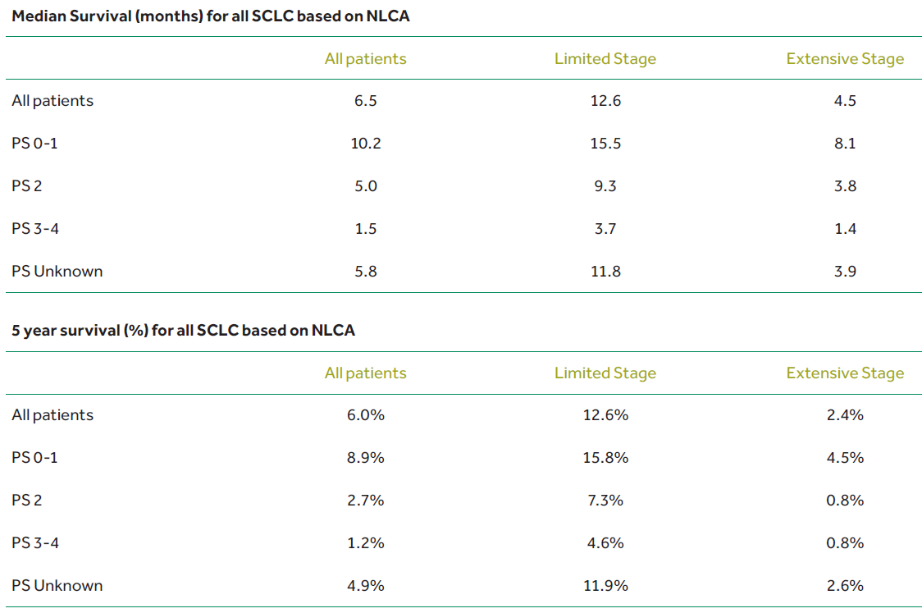
Small cell

Slide 43
Small cell survival

Slide 44
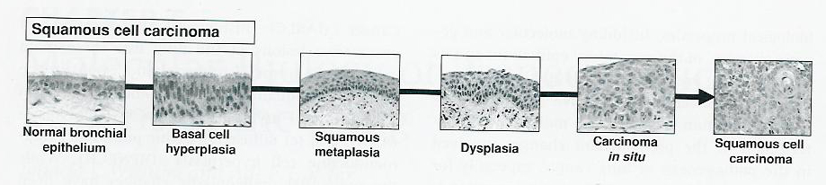
Development of squamous cell carcinoma
No squamous cells in normal airways
“Field carcinogenesis”
Tend to be central and very smoking related
Wistuba & Gazdar, Ch 5, p84-98, in Lung Cancer, 3rd Ed. Roth, Cox & Hong 2008.

Slide 45
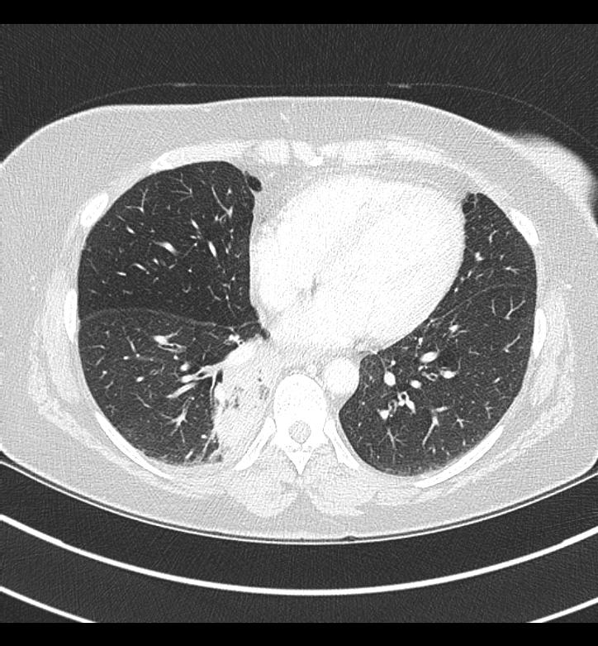
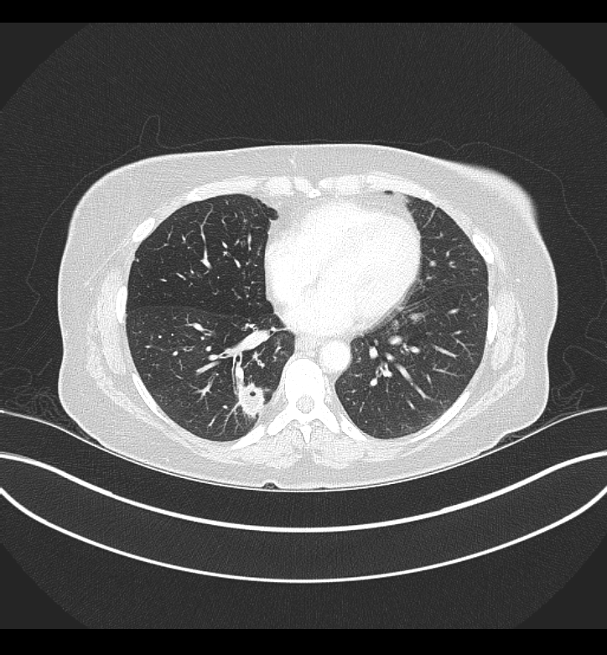
Squamous cell after pneumonia on emphysema background

Slide 46
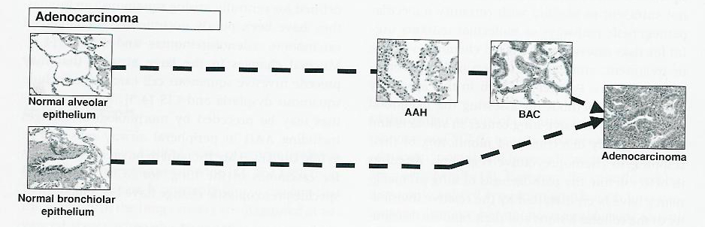
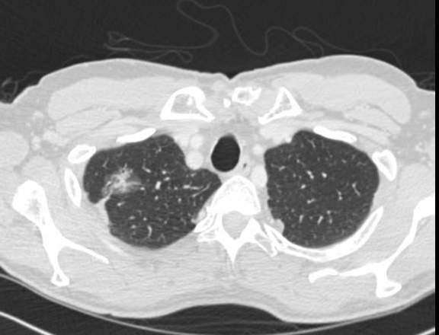
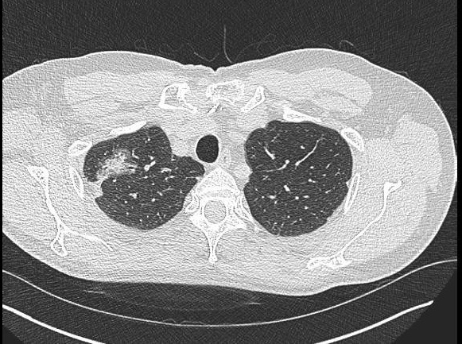
Development of Adenocarcinoma
2012
2015
Wistuba & Gazdar, Ch 5, p84-98, in Lung Cancer, 3rd Ed. Roth, Cox & Hong 2008.

Slide 47
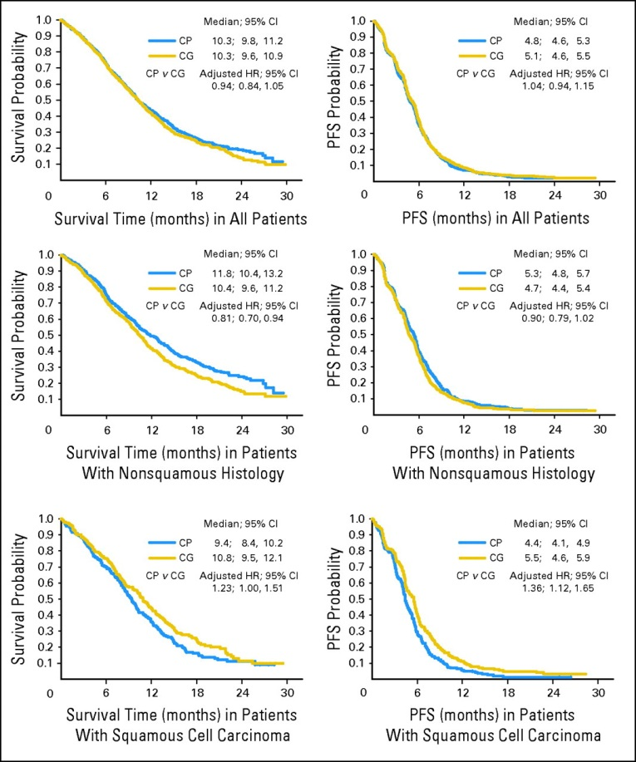
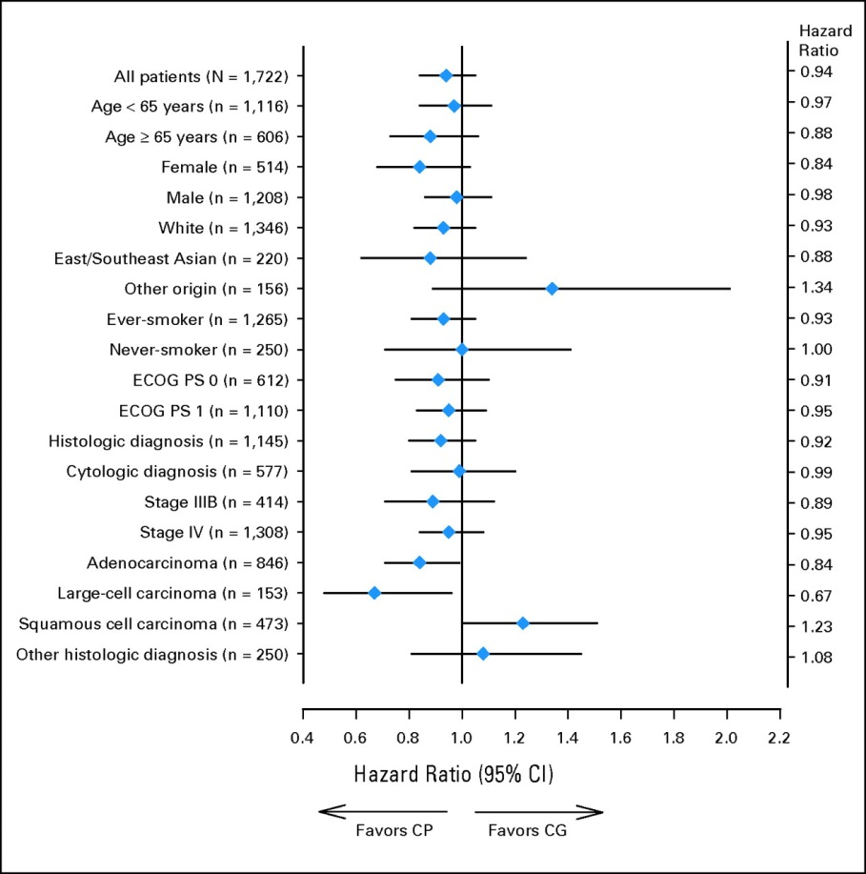
Why “Tissue is the issue” 1: Sq vs adeno
847 patients adenocarcinoma: improved survival for cisplatin plus pemetrexed arm compared with the cisplatin plus gemcitabine arm (12.6 v 10.9 months, respectively; hazard ratio = 0.84; 95% CI, 0.71 to 0.99; P = .03).
473 patients with squamous cell carcinoma survival favors cisplatin plus gemcitabine arm compared with the cisplatin plus pemetrexed arm (10.8 v 9.4 months, respectively; hazard ratio = 1.23; 95% CI, 1.00 to 1.51; P = .05).

Slide 48
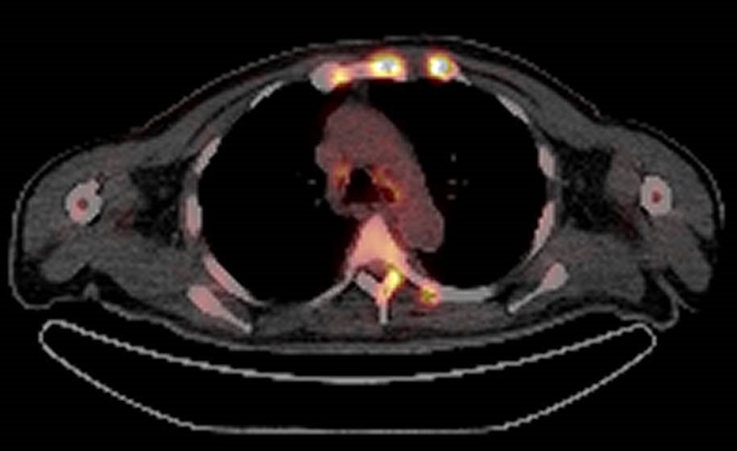
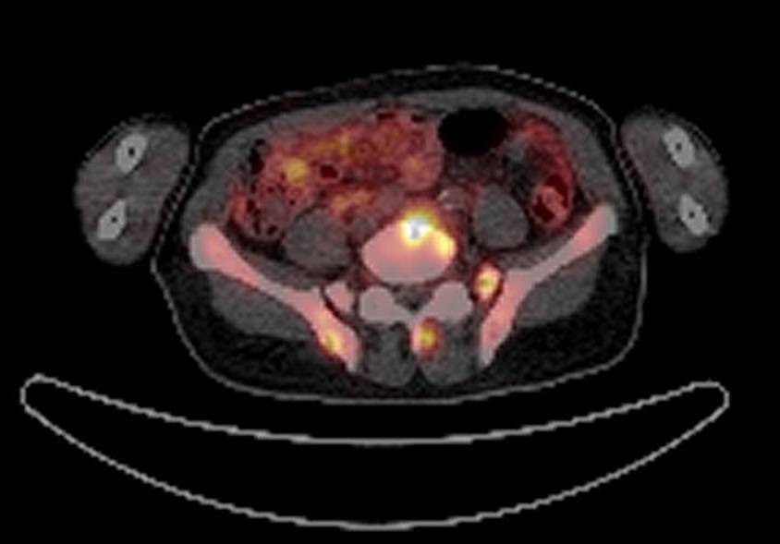
Why “Tissue is the issue” 2: 57yr male, anaemia, weight loss, very abnormal imaging
Conclusion: There are multiple intensely metabolically active lytic bone metastases. There are two muscle metastases in the left thigh and left upper arm. The CT appearances are also concerning for peritoneal metastatic disease which is below the resolution of PET.

Slide 49
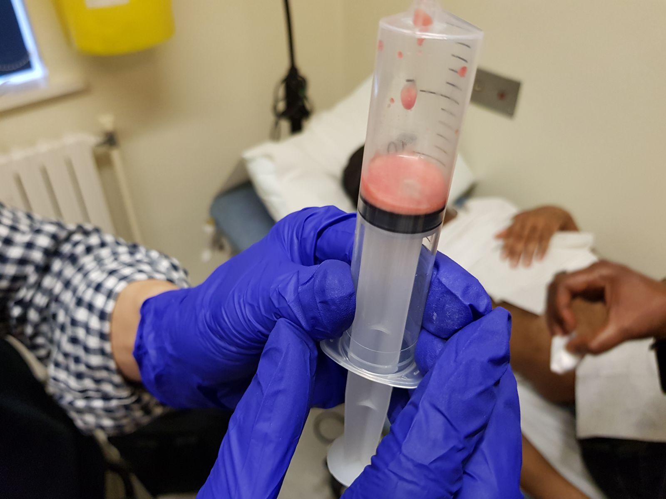
Why tissue is the issue 2: It’s not always cancer, even when the radiologist says it is
SPECIAL REQUEST STERNUM
DIRECT MICROSCOPY Auramine Stain:
Acid Alcohol Fast Bacilli scanty *** SEEN ***
Confirmed by ZN
CULTURE Acid Alcohol Fast Bacilli Organism isolated after 9 days
Culture confirmation test for M.tb complex: POSITIVE
Mycobacterium identified as Mycobacterium tuberculosis
Performed by Public Health England, Colindale
REPORT STATUS ORGANISM Mycobacterium identified as Mycobacterium tuberculosis
METHOD DISC SENSITIVITY
Rifampicin Sensitive
Pyrazinamide Sensitive
Isoniazid Sensitive
Ethambutol Sensitive
TB PCR
SPECIMEN DESCRIPTION Aspirate
DIRECT MICROSCOPY Mycobacterium tuberculosis complex PCR: POSITIVE.

Slide 50
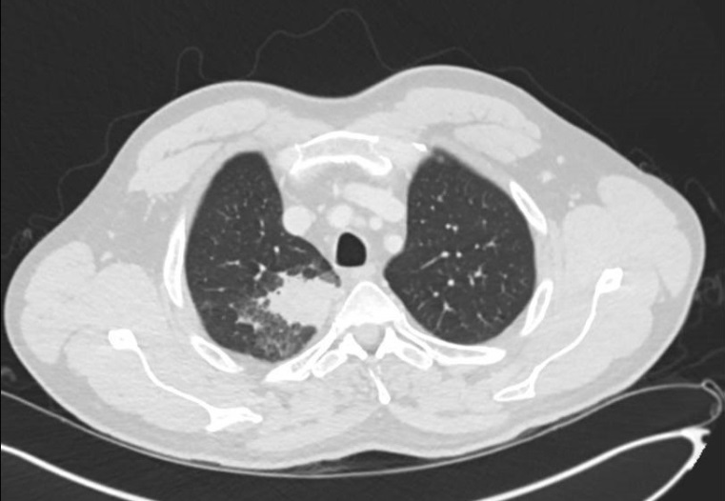
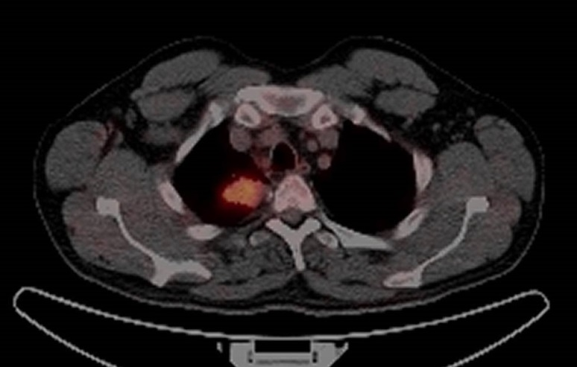
Learning point 2: It’s not always cancer even when the radiologist says so..
Aug 2016
Report:
4 cm mass in the right upper lobe as described, appearances are consistent with a primary lung malignancy.
Aug 2016

Slide 51
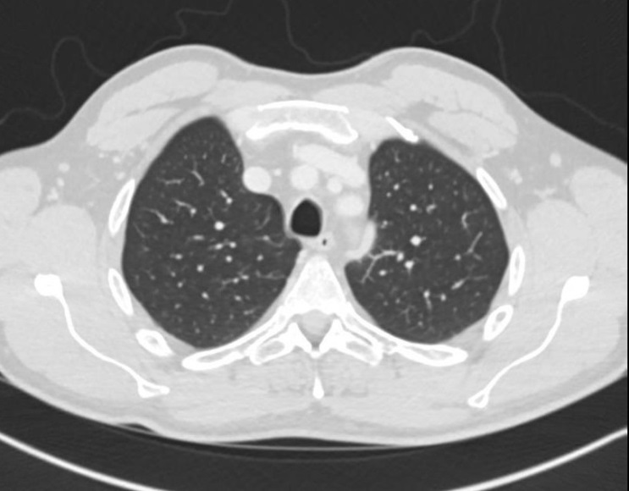
Learning point 2: It’s not always cancer even when the radiologist says so..
Aug 2016
Jan 2018
Report:
4 cm mass in the right upper lobe as described, appearances are consistent with a primary lung malignancy.
Aug 2016
Be very wary of telling people they have cancer: better to say there is an abnormality and the specialist team will see them

Slide 52
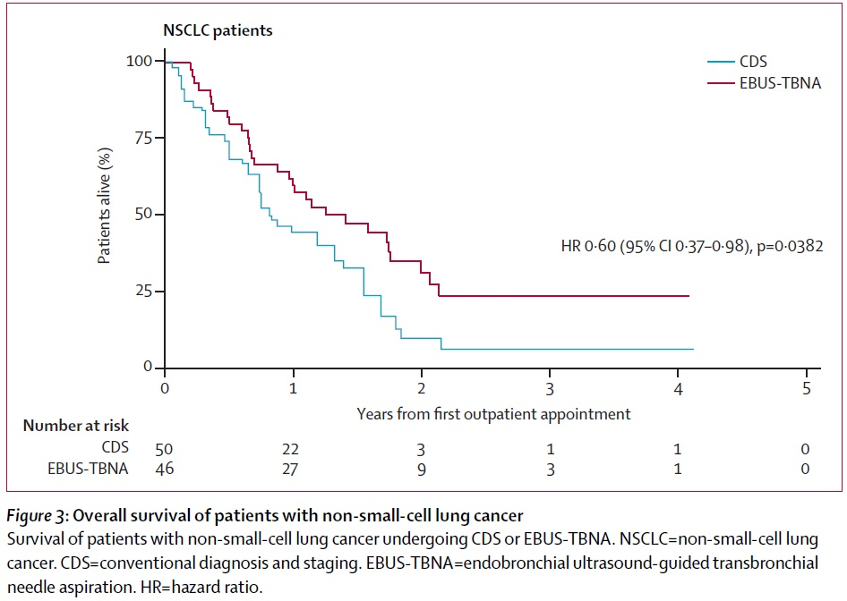
Why tissue is the issue 3: Tissue diagnosis and staging (with EBUS) improves survival
Navani, Lancet Resp Med 2015

Slide 53
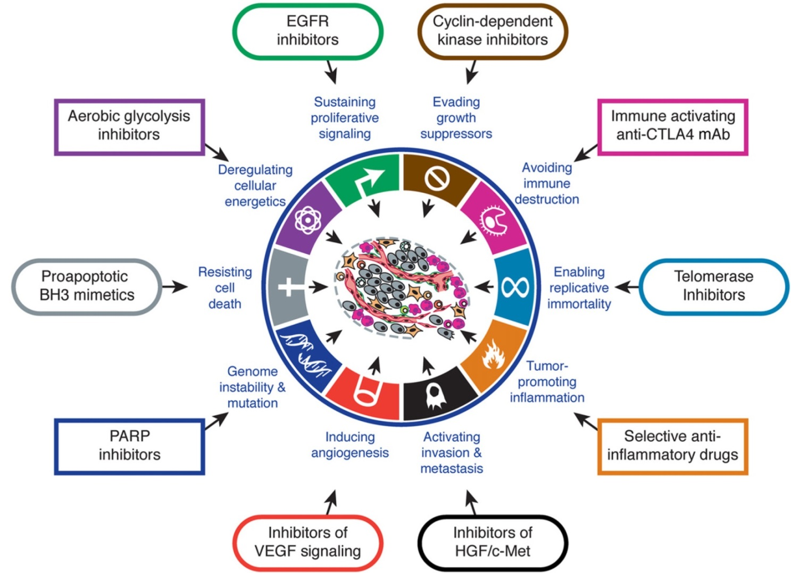
Tissue is the issue 4: Improved understanding: targeted therapies
Hanahan, Cell, 2011

Slide 54

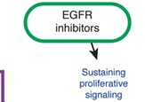
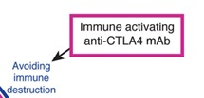
Tissue is the issue 4: Improved understanding: targeted therapies
Hanahan, Cell, 2011

Slide 55
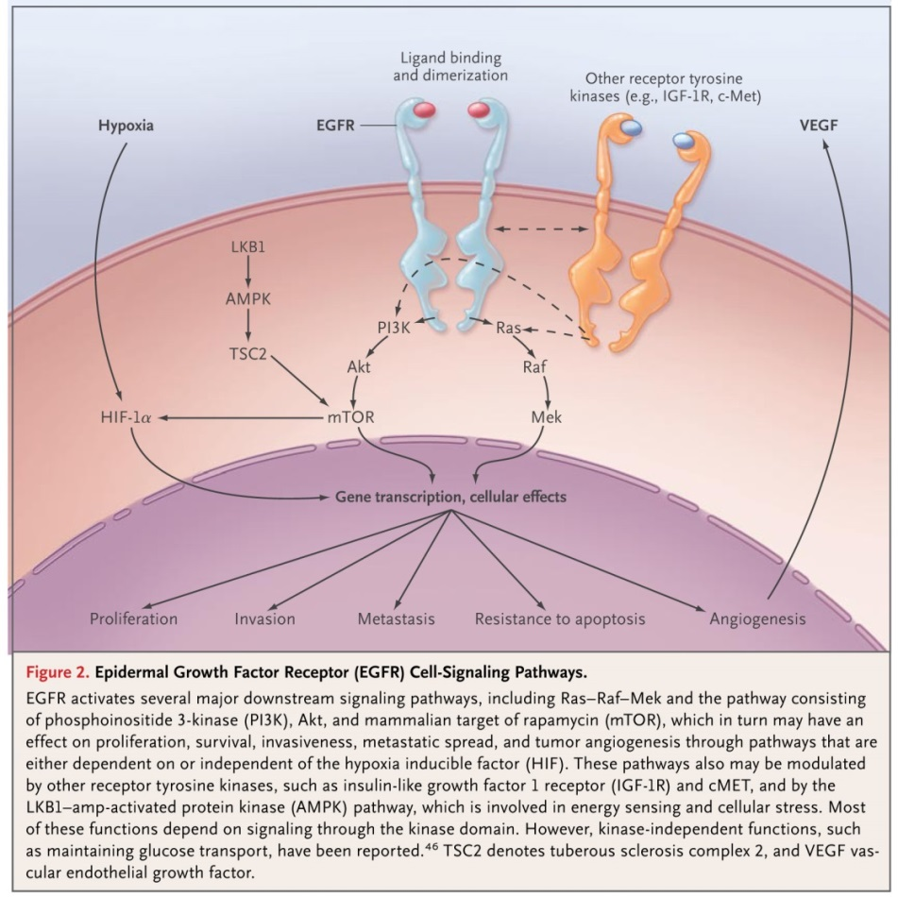

Exploiting oncogene addiction: targeted therapy: EGFR-TKI
Herbst, NEJM, 2008

Slide 56


Treatments Chemotherapy
Cochrane meta-analysis showed a significant benefit of chemotherapy over best supportive care (HR = 0.77; 95% CI 0.71 to 0.83, P < 0.0001), equivalent to a relative increase in survival at 1 year of 23%, an absolute improvement in survival of 9% at 12 months, increasing survival from 20% to 29% or an absolute increase in median survival of 1.5 months (from 4.5 months to six months).

Slide 57

Targeted therapies improve outcomes
EGFR-Tki
Increase in PFS
Non-smokers
Rosell.LancetOncol.2012.EURTAC

Slide 58

Targeted therapies improve outcomes
ALK inhibition
(crizotinib)
Increase in PFS

Slide 59


Targeted therapies improve outcomes
Immunotherapy
Anti-PDL1
Influence of proportion tumour cells expressing PDL-1
Very expensive
Important to remember not chemo: side effects of overactivating immune system, not neutropenia
Pneumonitis, colitis etc

Slide 60

Palliative Care
Cryo, Stent, Radio
Dex, Radio (PS 0,1)
Radio
Opioids, Vocal cord medialisation, NOT O2
Stent
PleurX
Drain, PleurX, Pleurodesis

Slide 61
Palliative care
Improved survival!
fewer patients in early palliative care group received aggressive end-of-life care (33% vs. 54%, P=0.05)
median survival was longer with early palliative care (11.6 months vs. 8.9 months, P=0.02)
Improved quality of life and depression scores
Temel, NEJM, 2010

Slide 62

SVCO
60-85% due to malignancy
Presenting feature in 60%
Non small cell: 50%;
(<2% of patients with NSLCLC)
Small cell: 25%
(10% of small cell cases)
Non Hodgkin’s 10%
Tissue diagnosis (EBUS, neck node biopsy) important as Lymphoma and Small cell will respond to chemo
Non small cell: consider SVC stent then Chemoradiotherapy
Consider steroids pending biopsy/ definitive treatment
If airway compromise or CNS (drowsy/ raised ICP): stent, emergency radiotherapy

Slide 63
MSCC (metastatic spinal cord compression) - Who?
Warn at risk patients (patients with diagnosed bone metastases, or patients with cancer who present with spinal pain ) and ensure they have contact numbers
Contact the MSCC coordinator urgently (within 24 hours) to discuss the care of patients with cancer and any of the following symptoms:
pain in the middle (thoracic) or upper (cervical) spine
progressive lower (lumbar) spinal pain
severe unremitting lower spinal pain
spinal pain aggravated by straining (for example, at stool, or when coughing or sneezing
localised spinal tenderness
nocturnal spinal pain preventing sleep.
Contact the MSCC coordinator immediately and view them as an oncological emergency:
neurological symptoms including radicular pain, any limb weakness, difficulty in walking, sensory loss or bladder or bowel dysfunction
neurological signs of spinal cord or cauda equina compression.

Slide 64
MSCC (metastatic spinal cord compression)
Do not perform plain radiographs of the spine either to make or to exclude the diagnosis of spinal metastases or MSCC.
MRI WHOLE SPINE unless contraindicated (in which case discuss)
If MRI is not available: transfer patients with suspected MSCC to a unit with 24-hour capability for MRI and definitive treatment of MSCC.
MRI in time to allow definitive treatment to be planned within 1 week
MRI within 24 hours spinal pain and neurological symptoms or signs.
Out of hours MRI only if emergency need and intention to treat immediately.
If severe pain or neurology - Nurse as unstable spine ('log rolling' slipper pan for toilet)
Analgesia
Dexamethasone 16mg loading, then daily pending treatment in confirmed
Wean after treatment
Bisphosphonates (breast, prostate, myeloma)
Radiotherapy
Surgery

Slide 65
Haemoptysis
Rare
Asphyxiation is the problem not bleeding
Anaesthetist rather than transfusion
Lie on affected side (side of tumour)
CT aorta (if / when stable)
Bronchoscopy? Balloons/ adrenaline/ laser/cryo some centres
Interventional radiology + embolisation
Surgery
Tranexamic acid; opiates (suppress cough)
Radiotherapy

Slide 66

Screening?
NLST 2011
55 and 74 years with a minimum of 30 pack-years of smoking and no more than 15 years since quitting.
20% reduction in mortality
NNT approx 320
But: 95% false positives; anxiety, healthcare use, morbidity: NODULES
1. Reduced lung-cancer mortality with low-dose computed tomographic screening.National Lung Screening Trial Research Team, NEJM 2011
2. Results of the Two Incidence Screenings in the National Lung Screening Trial, Aberle et al for the National Lung Screening Trial Research TeamN Engl J Med 2013; 369:920-931September 5, 2013
3. Targeting of Low-Dose CT Screening According to the Risk of Lung-Cancer Death; Kovalchik, et al, N Engl J Med 2013; 369:245-254July 18, 2013
Notes:
hree randomized studies provided evidence on the effect of LDCT screening on lung cancer mortality, of which the National Lung Screening Trial was the most informative, demonstrating that among 53,454 participants enrolled, screening resulted in significantly fewer lung cancer deaths (356 vs 443 deaths; lung cancer−specific mortality, 274 vs 309 events per 100,000 person-years for LDCT and control groups, respectively; relative risk, 0.80; 95% CI, 0.73-0.93; absolute risk reduction, 0.33%; P = .004). The other 2 smaller studies showed no such benefit. In terms of potential harms of LDCT screening, across all trials and cohorts, approximately 20% of individuals in each round of screening had positive results requiring some degree of follow-up, while approximately 1% had lung cancer. There was marked heterogeneity in this finding and in the frequency of follow-up investigations, biopsies, and percentage of surgical procedures performed in patients with benign lesions. Major complications in those with benign conditions were rare.CONCLUSION:Low-dose computed tomography screening may benefit individuals at an increased risk for lung cancer, but uncertainty exists about the potential harms of screening and the generalizability of results.
The result of the NLST is the first indication that any test can reduce deaths from lung cancer. The study involved more than 50,000 current and former heavy smokers — people who smoked the equivalent of a pack of cigarettes a day for 30 years — ages 55 to 74. Participants were randomized between low-dose spiral CT scan and chest X-ray at the start of the trial. They received annual screening tests for three years and then were followed for five years. The initial results of this trial revealed a reduction in lung cancer deaths with CT scan screening. The results showed 354 lung cancer deaths had occurred among those who had been screened with CT scan vs. 442 deaths among those who were screened with chest X-ray. That represents a 20.3 percent reduction with CT screening.
66

Slide 67


Pulmonary nodules are common and usually benign
1. Pulmonary nodules are common
In high risk populations (e.g. lung cancer screening) 20-50% individuals
Around 30% in most large screening studies
2. A minority of these will be lung cancer
Around 1.5%
British Thoracic Society
Better lung health for all
Callister, ME et al, Thorax. 2015 Aug;70 Suppl 2:ii1-ii54. doi: 10.1136/thoraxjnl-2015-207168.
Notes:
Split up and add tables from nodule guideline showing prevalence
Take Table 4 from NLST paper for complications and update with UK surgery risks

Slide 68
Pulmonary nodules get better on their own
3. Some nodules will resolve spontaneously
10% in NELSON (Dutch-Belgian Lung cancer screening);
8% by 3 months
Spiculated nodules 4x chance of disappearing
Zhao, Radiology, 2014
12% after antibiotics by 2 months in Early Lung Cancer Action Project
Libby, Chest, 2006
Notes:
Split up and add tables from nodule guideline showing prevalence
Take Table 4 from NLST paper for complications and update with UK surgery risks

Slide 69

Investigation has risks
2% 30 day mortality, 4% 90 day mortality lung cancer resection
0.4% inpatient mortality thoracoscopic wedge resection
Bronch/ EBUS: 1 in 5000 death
CT biopsy
Pneumothorax risk 15%; 6.6% chest drain; 1 in 4000-15000 death from air embolus
Haemorrhage 1.0% of cases
Wiener RS, Ann Intern Med 2011;155:137–44.
NLST 2011
Aberle, NEJM, 2011
Notes:
Split up and add tables from nodule guideline showing prevalence
Take Table 4 from NLST paper for complications and update with UK surgery risks

Slide 70



Size important but non-linear
McWilliams A, Tammemagi MC, Mayo JR, et al. Probability of cancer in pulmonary nodules detected on ﬁrst screening CT. N Engl J Med 2013;369:910–9.

Slide 71

Not all nodules are the same

Slide 72


Initial approach Solid Nodules

Slide 73
Initial approach Solid Nodules

Slide 74


What factors do you need to know?
Age
Gender
Family History lung cancer
(Smoking history)
Previous cancer?
Emphysema
Size
Solid/ part solid / pure ground glass
No. nodules
Lobe
Spiculation
FDG uptake
British Thoracic Society
Better lung health for all
Callister, ME et al, Thorax. 2015 Aug;70 Suppl 2:ii1-ii54. doi: 10.1136/thoraxjnl-2015-207168.

Slide 75
Initial approach Solid Nodules

Slide 76

Surveillance Solid Nodules

Slide 77
Surveillance Solid Nodules

Slide 78
Surveillance Solid Nodules

Slide 79

Sub-Solid Nodules – note no role for PET

Slide 80
Sub-Solid Nodules

Slide 81
Sub-Solid Nodules

Slide 82
Sub-Solid Nodules

Slide 83
3 most important things you can do
1. Refer/ advise on smoking cessation:
National referral system
https://nww.referralshub.eastmidlands.nhs.uk/NewReferral/imperial
Complete “very brief advice” training module
http://www.ncsct.co.uk/publication_very-brief-advice.php
2. Assess and record performance status accurately
3. Refer to Lung MDT/ nodule MDT/ Resp team
Don’t just follow the x-ray report or acute oncology advice

